Slide 1
ABOUT ME
STUDENT NAME : Akash j REGISTER NO & NMID : 2422J1099
NMID :asburu002422j199
DEPARTMENT : BCA COLLEGE : CGAC(Tiruppur)

Slide 2
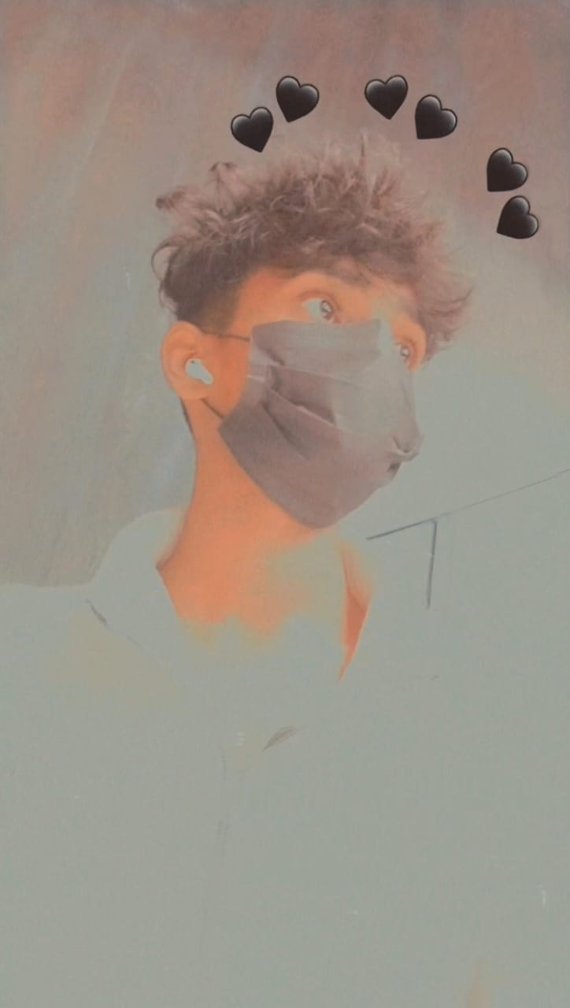
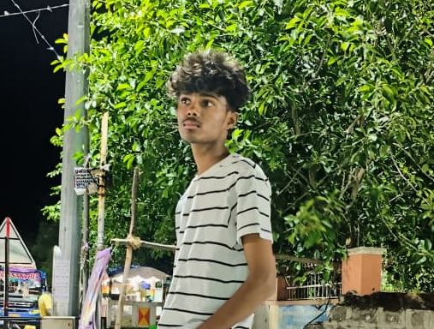
DIGITAL PROTFOLIO
AKASH J

Slide 3

AGENDA
1.Introduction
2.Problem statement
3.project overview
4.end user
5.tools and technologies
6.portfolio design and layout
7.features and functionality
8.results and screenshots
9.conclusion
10.github link

Slide 4

Introduction
This presentation provides an overview of my portfolio, highlighting key projects and skills developed throughout my professional journey. It aims to inform and engage the audience about my capabilities as a developer and designer.
Through a structured agenda, we will explore various aspects, including problem statements, technologies used, and results achieved, culminating in a comprehensive understanding of my work.

Slide 5
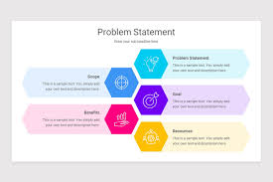
Problem statement
In this slide, we will discuss the core problem that each project aimed to address.
Identifying the problem is crucial as it leads to the formulation of effective solutions.
We will explore the context around these challenges and how they influenced project goals and designs.

Slide 6

Project overview
This section will introduce my portfolio, outlining the core areas that are represented within it.
It will discuss the inspiration behind the projects and how they reflect my skills and expertise in the field.
Additionally, it will emphasize the importance of this portfolio in showcasing my professional identity and capabilities.

Slide 7

End users
Since end users are most often lay persons without expert knowledge or particular skills, companies need to ensure that the user experience is straightforward, intuitive, and effective

Slide 8

Tools and technologies used
Here, we will delve into the specific tools and technologies that were employed across various projects.
This includes programming languages, software platforms, and any frameworks that facilitated development and design.
An understanding of these technologies will provide insights into the technical skills applied in each project.

Slide 9

Project design and layout
Sections included:
Hero section with name and tagline
About Me section
Skills and Technologies
Featured Projects with live preview and GitHub links
Contact Form and Resume download
Footer with social media links

Slide 10

Features and functionality
This section highlights key features and functionalities of the projects within the portfolio.
We will cover the user experience, design elements, and unique aspects that differentiate each project.
Emphasis will be placed on how these features meet user needs and solve the identified problems.

Slide 11
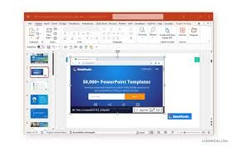
Result and screenshot
The portfolio received positive feedback from peers and mentors. It helped in attracting job interviews and freelance inquiries.

Slide 12

conclutions
In conclusion, the portfolio clearly demonstrates my skills, creativity, and problem-solving abilities.
Each project presented not only showcases my technical competencies but also reflects my approach to addressing real-world challenges.
Thank you for your attention, and I look forward to any questions or feedback on my work.

Slide 13

Github link

Slide 14
*Thank you*

